Slide 1
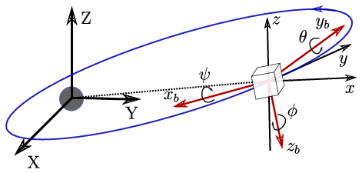
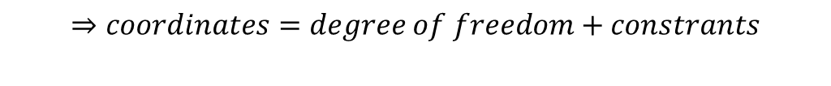
Course I: Kinematics: Describing the Motions of spacecraft
1. Performed Attitude Method
The orientation of the body frame with respect to the reference frame is given by satellite's attitude.
This orientation is represented by a proper orthogonal matrix called as rotation matrix or attitude matrix.
A minimum of three coordinates is required to describe the relative angular displacement between two reference frames.
$$⇒coordinates=degree of freedom+constrants$$

Slide 2
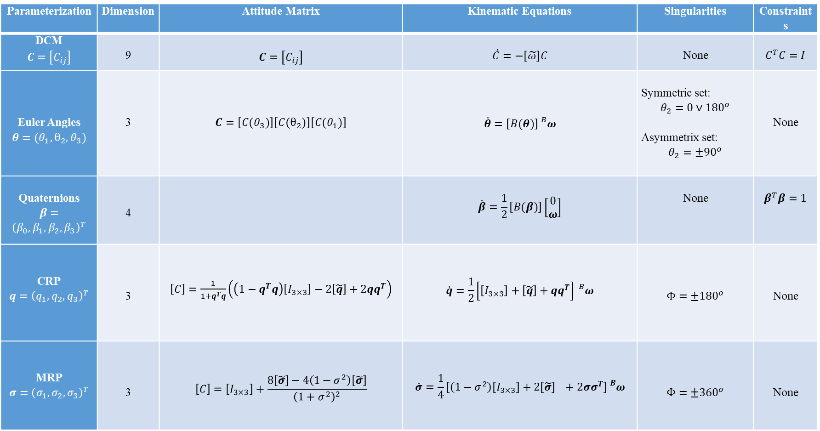
Course I: Kinematics: Describing the Motions of spacecraft
Parameterization | Dimension | Attitude Matrix | Kinematic Equations | Singularities | Constraints
DCM $$C=\left[C_{ij}\right]$$ | 9 | $$C=\left[C_{ij}\right]$$ | $$\dot{C}=−\left[\tilde{ω}\right]C$$ | None | $$C^{T}C=I$$
Euler Angles $$θ=(θ_{1},θ_{2},θ_{3})$$ | 3 | $$C=\left[C(θ_{3})\right]\left[C(θ_{2})\right]\left[C(θ_{1})\right]$$ | $$\dot{θ}=\left[B(θ)\right]{}_{}^{B}ω$$ | Symmetric set: $$θ_{2}=0∨{180}^{o}$$ Asymmetrix set: $$θ_{2}=±{90}^{o}$$ | None
Quaternions $$β=$$ $${\left(β_{0},β_{1},β_{2},β_{3}\right)}^{T}$$ | 4 |  | $$\dot{β}=\frac{1}{2}\left[B(β)\right]\left[\begin{matrix}0 \\ ω\end{matrix}\right]$$ | None | $$β^{T}β=1$$
CRP $$q={\left(q_{1},q_{2},q_{3}\right)}^{T}$$ | 3 | $\left[C\right]=\frac{1}{1+q^{T}q}\left(\left(1−q^{T}q\right)\left[I_{3×3}\right]−2\left[\tilde{q}\right]+2qq^{T}\right)$ | $$\dot{q}=\frac{1}{2}\left[\left[I_{3×3}\right]+\left[\tilde{q}\right]+qq^{T}\right]{}_{}^{B}ω$$ | $$Φ=±{180}^{o}$$ | None
MRP $$σ={\left(σ_{1},σ_{2},σ_{3}\right)}^{T}$$ | 3 | $$\left[C\right]=\left[I_{3×3}\right]+\frac{8\left[\tilde{σ}\right]−4\left(1−σ^{2}\right)\left[\tilde{σ}\right]}{{\left(1+σ^{2}\right)}^{2}}$$ | $$\dot{σ}=\frac{1}{4}\left[\left(1−σ^{2}\right)\left[I_{3×3}\right]+2\left[\tilde{σ}\right] +2σσ^{T}\right]{}_{}^{B}ω$$ | $$Φ=±{360}^{o}$$ | None

Slide 3
Course I: Kinematics: Describing the Motions of spacecraft
2. Attitude Determination:

